Slide 1
__ __ ______ _____ ______ ______ __ __
/\ "-./ \ /\ __ \ /\ __-. /\ ___\ /\ == \ /\ "-.\ \
\ \ \-./\ \ \ \ \/\ \ \ \ \/\ \ \ \ __\ \ \ __< \ \ \-. \
\ \_\ \ \_\ \ \_____\ \ \____- \ \_____\ \ \_\ \_\ \ \_\\"\_\
\/_/ \/_/ \/_____/ \/____/ \/_____/ \/_/ /_/ \/_/ \/_/
______ ______ __ __ ______ __ __ ______ __ __ __ ______
/\ ___\ /\ __ \ /\ "-./ \ /\ == \ /\ \/\ \ /\__ _\ /\ \ /\ "-.\ \ /\ ___\
\ \ \____ \ \ \/\ \ \ \ \-./\ \ \ \ _-/ \ \ \_\ \ \/_/\ \/ \ \ \ \ \ \-. \ \ \ \__ \
\ \_____\ \ \_____\ \ \_\ \ \_\ \ \_\ \ \_____\ \ \_\ \ \_\ \ \_\\"\_\ \ \_____\
\/_____/ \/_____/ \/_/ \/_/ \/_/ \/_____/ \/_/ \/_/ \/_/ \/_/ \/_____/
______ ______ ______
/\ ___\ /\ __ \ /\ == \
\ \ __\ \ \ \/\ \ \ \ __<
\ \_\ \ \_____\ \ \_\ \_\
\/_/ \/_____/ \/_/ /_/
______ __ ______ __ ______ ______ __ ______ ______ ______
/\ == \ /\ \ /\ __ \ /\ \ /\ __ \ /\ ___\ /\ \ /\ ___\ /\__ _\ /\ ___\
\ \ __< \ \ \ \ \ \/\ \ \ \ \____ \ \ \/\ \ \ \ \__ \ \ \ \ \ \___ \ \/_/\ \/ \ \___ \
\ \_____\ \ \_\ \ \_____\ \ \_____\ \ \_____\ \ \_____\ \ \_\ \/\_____\ \ \_\ \/\_____\
\/_____/ \/_/ \/_____/ \/_____/ \/_____/ \/_____/ \/_/ \/_____/ \/_/ \/_____/
_ ___ _ _
/\/\ ___ __| | ___ _ __ _ __ / __\___ _ __ ___ _ __ _ _| |_(_)_ __ __ _
/ \ / _ \ / _` |/ _ \ '__| '_ \ / / / _ \| '_ ` _ \| '_ \| | | | __| | '_ \ / _` |
/ /\/\ \ (_) | (_| | __/ | | | | | / /___ (_) | | | | | | |_) | |_| | |_| | | | | (_| |
\/ \/\___/ \__,_|\___|_| |_| |_| \____/\___/|_| |_| |_| .__/ \__,_|\__|_|_| |_|\__, |
|_| |___/
__ ___ _ _ _ _
/ _| ___ _ __ / __(_) ___ | | ___ __ _(_)___| |_ ___
| |_ / _ \| '__| /__\// |/ _ \| |/ _ \ / _` | / __| __/ __|
| _| (_) | | / \/ \ | (_) | | (_) | (_| | \__ \ |_\__ \
|_| \___/|_| \_____/_|\___/|_|\___/ \__, |_|___/\__|___/
|___/
A blitz through some useful concepts and tools

Slide 2

An Excellent Book
Reformatting data with regex
The Unix command line
Combining and automating analyses
Python programming and debugging
Creating and editing graphics
Databases
Performing analyses remotely

Slide 3
Most-everything we do
You can find:
https://github.com/brevans/MPS_Workshop

Slide 4
Outline
Intro
Underlying concepts
Where’s the mouse?
Looking around
Permissions
Getting around
File commands
File I/O
Redirection
pipelines

Slide 5
Some Conventions
Descriptions
$ command
1Il|iO0oB8
1Il|iO0oB8
#comments

Slide 6
General Guidance
1. Google/Bing/Yahoo are your friends.
Also, don’t forget to read documentation
2. Keep backups of everything you can.
3. Use workflows that are non-destructive.
4. Don’t be afraid to break stuff.

Slide 7

Why linux
Free (libre and usually gratis)
Portable
I write a program, and you can usually run it!
Ubiquitous and universal*
Runs on most modern hardware
One set (or only a few sets) of instructions
Steep learning curve
Enormous dividends!!
Alleviated with gui-based distro

Slide 8
Unix philosophy
Doug McIlroy:
Write programs that do one thing and do it well.
Write programs to work together.
Write programs to handle text streams, because that is a universal interface.
Notes:
Head of Bell Labs Computing Sciences Research Center

Slide 9

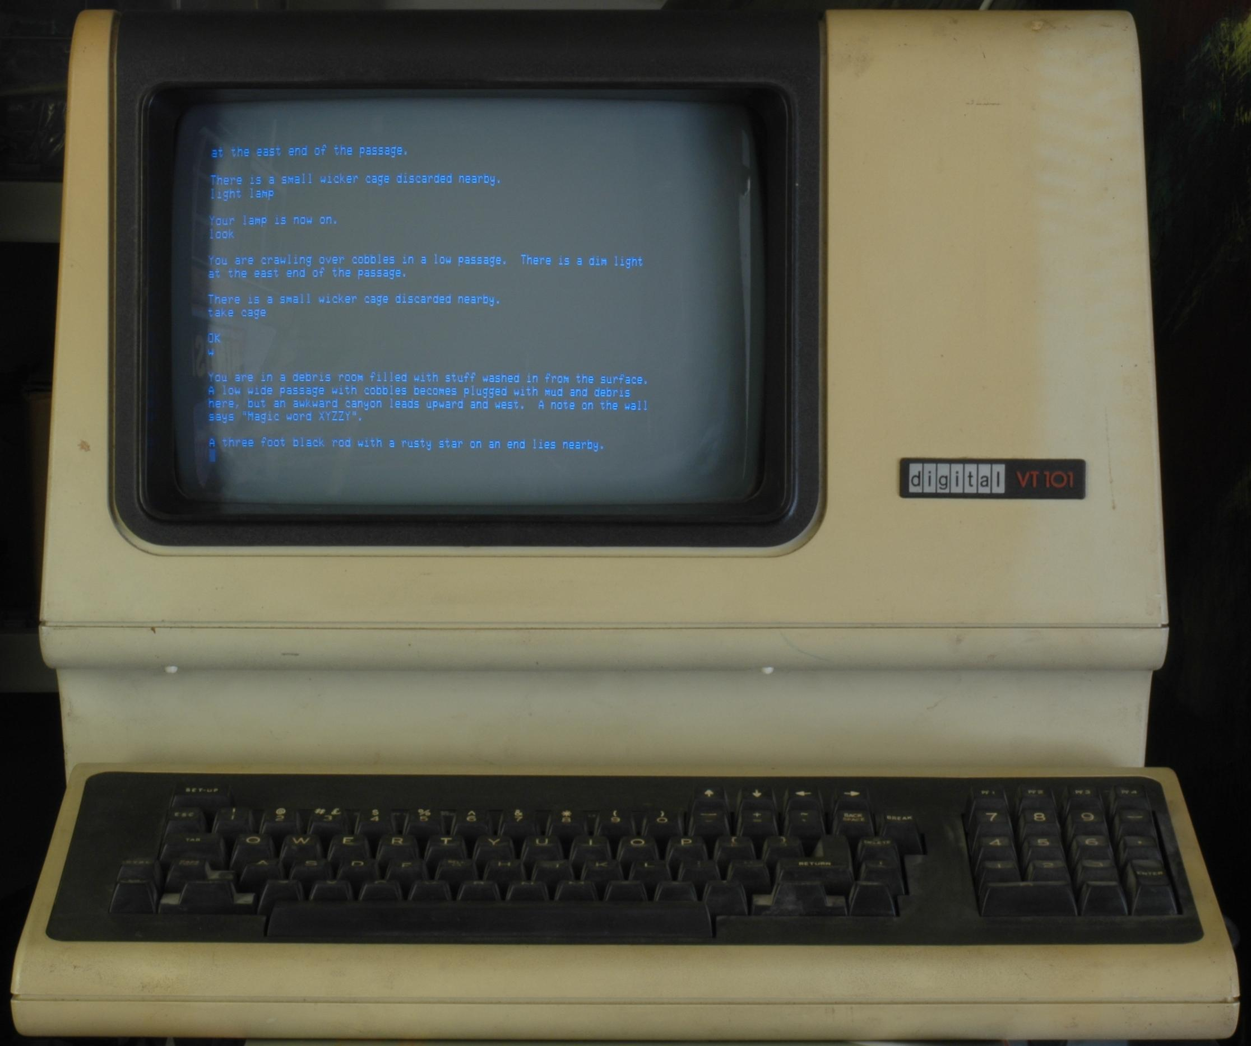
Where’s my mouse pointer?
Text commands more flexible & powerful
Like computer shorthand
But you have to know the lingo
Keeping hands on the keyboard saves time (eventually)
Lower system overhead
Easier access and use of remote systems

Slide 10
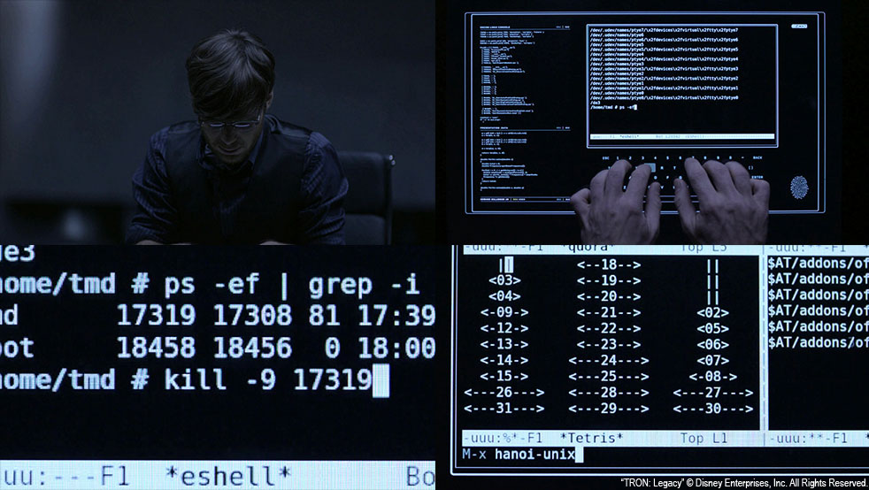
Where’s my mouse pointer?
With programs & scripts
Run less risk of insidious mistakes
More reproducible
Saves time if you need to repeat!

Slide 11
However…
For certain projects, what we’re discussing is overkill
Use tools that you understand and that will save you time
Excel, or even a simple calculator!

Slide 12
One slide about computer hardware
CPU – Central Processing Unit
Usually where your numbers get crunched
Modern computers usually have several
RAM – Random Access Memory
Fast place to work, but volatile and small
Think of this as a small desktop surface
Disk – Hard Drives, Solid State Drives
Stable, long(er) term storage
Think of this as a filing cabinet

Slide 13
a shell
A program that interprets commands
Not an OS
An interface to OS to run commands.
bash: the Bourne Again Shell
Free replacement to Steve Bourne’s Shell
ssh: Secure Shell
cryptographic network protocol for secure data communication

Slide 14
Shell tricks
what was that command?
$ history
last command: up/down arrows
tab completion!
ctrl-r to search command history
ctrl-a/ctrl-e jump to beginning/end of line

Slide 15
Shell tricks
Stop!!!
ctrl-c for break or interrupt
We’re done here
ctrl-d for end of transmission
I want a real tab character!
ctrl-v to insert literal keypress

Slide 16
Diving in
Type a command, press enter(or return)
Results will be printed to screen*
CASE SENSITIVE
<tab> completion is your friend!
Up/down arrows are your friends!
[be59@login-0-0 ~]$ echo "HELLO"
HELLO
username
computer name
current directory
command (program)
output
argument(s)

Slide 17
Help!
[be59@login-0-0 ~]$ man echo
ECHO(1) User Commands ECHO(1)
NAME
echo - display a line of text
SYNOPSIS
echo [SHORT-OPTION]... [STRING]...
echo LONG-OPTION
DESCRIPTION
Echo the STRING(s) to standard output.
-n do not output the trailing newline

Slide 18
Getting Around
Where am I?
[be59@login-0-0 ~]$ pwd
/home/be59
What’s here?
[be59@login-0-0 ~]$ ls
bin bio ddRAD de225 Jtown lins_folder local_ompi proj ref runFastQC scratch tmp

Slide 19
ls
[be59@login-0-0 ~]$ ls -lah
total 1.2M
drwxr-xr-x 23 be59 caccone 58K Oct 29 23:07 .
drwxr-xr-x 64 root root 0 Oct 29 22:12 ..
-rw------- 1 be59 caccone 33K Oct 23 16:25 .bash_history
-rw-r--r-- 1 be59 caccone 33 Jan 21 2009 .bash_logout
-rw-r--r-- 1 be59 caccone 176 Jan 21 2009 .bash_profile
-rw-r--r-- 1 be59 caccone 1.3K Oct 2 11:17 .bashrc
-rw-r--r-- 1 be59 caccone 1.3K Sep 21 10:13 .bashrc~
drwxr-xr-x 5 be59 caccone 8.0K Sep 23 13:41 bin
drwxr-xr-x 4 be59 caccone 2.0K Jan 9 2013 bio
drwxr-xr-x 4 be59 caccone 2.0K Jun 19 17:10 .config
drwxr-xr-x 3 be59 caccone 2.0K Aug 24 2012 ddRAD
lrwxrwxrwx 1 be59 caccone 11 Dec 13 2011 de225 -> /home/de225
Permissions
everyone
my group
symlink (more on this soon)
me

Slide 20
chmod: permissions
User, Group, Others
Can use ‘octal’ but it’s unintuitive
777? 755? 765? 000?
Example:
#give me read and write access, everyone else only read access
$ chmod u=rw,go=r file.txt

Slide 21
Getting Around
What kind of file is this?
[be59@login-0-0 ~]$ file bin
bin: directory
[be59@login-0-1 ~]$ file de225
de225: symbolic link to `/home/de225’
[be59@login-0-1 ~]$ file bin/varfilter.py
bin/varfilter.py: a /software/bin/python script text executable

Slide 22
Changing Directories
[be59@login-0-0 ~]$ cd bin
[be59@login-0-0 bin]$
Or
[be59@login-0-0 bin]$ cd /home/be59/scratch/
[be59@login-0-0 scratch]$
directory separator
path

Slide 23
Path shortcuts: there’s no place like ~
. or ./ #this directory
.. or ../ #the directory “above”
~ #your home
~be59 #home directory for user be59
cd ~ #go home
cd #also takes you home
cd - #go to the last directory

Slide 24
Moving & Copying Files
Copy a file
$ cp file.txt new_file.txt
Moving and renaming is the same thing!
$ mv new_file.txt another_new_file
Making a directory
$ mkdir my_new_dir

Slide 25
Linking
Shortcuts to files
Great alternative to copying large files
ln
$ ln –s /path/to/big.txt free_copy.txt

Slide 26
Viewing Files: cat, head and tail
#spit out the WHOLE file
$ cat file.txt
this is a file!
it contains two lines of text.
$ cat file2.txt
this is another file.

Slide 27
Viewing Files: cat, head and tail
#spit out the first 10 lines of file
$ head file.txt
this is a file!
it contains two lines of text.
#try this!
$ head sample_2.fastq
#first N lines
$ head –n 100 sample4.fastq

Slide 28
Viewing Files: cat, head and tail
#spit out the last 10 lines
#try this!
tail sample_2.fastq
#last N lines
tail –n 50 sample_2.fastq

Slide 29
less is more
#interactive file viewing
$ less file.txt
arrow keys to navigate
-S to stop wrapping long lines
g and G to go to the start/end of file
% or p 50 to go to the middle of the file
-R to display escape characters as raw
q to quit

Slide 30
Files! Wild*ds!
$ cat file.txt file2.txt
this is a file!
it contains two lines of text.
this is another file.
$ cat file*
this is another file.
this is a file!
it contains two lines of text.

Slide 31
Wildcards everywhere
$ ls *.fa
seq1.fa seq2.fa
$ cat *.fa
>seq1
CGATCGATGCATCGTAGCTAGCTAGCTAGCTGA
>seq2
GTCGACTGCAGTCAGTCAGTCTAGCTAGCAGCTCA

Slide 32

caveat actor
“… the possession of great power necessarily implies great responsibility.”
~Thomas C. Hansard, (1817)
Computers will do exactly what you ask them to!!!
rm –rf ./*
rm –rf ./ *
rm –rf /*
rm –rf *

Slide 33
Finding files
where is the executable?
which grep
/bin/grep
locate (fast & easy), find (slow & hard)
locate grep
find ~be59/MPS_workshop -name \*.fa
what’s this?

Slide 34
The Escape character
often the “\” character
It means ignore what meaning the next character usually has in this context
\t, \n, \*, \., \
\
\
\

Slide 35
File Editing
iLE88Dj. :jD88888Dj:
.LGitE888D.f8GjjjL8888E; .d8888b. 888b 888 888 888
iE :8888Et. .G8888. d88P Y88b 8888b 888 888 888
;i E888, ,8888, 888 888 88888b 888 888 888
D888, :8888: 888 888Y88b 888 888 888
D888, :8888: 888 88888 888 Y88b888 888 888
D888, :8888: 888 888 888 Y88888 888 888
D888, :8888: Y88b d88P 888 Y8888 Y88b. .d88P
888W, :8888: "Y8888P88 888 Y888 "Y88888P"
W88W, :8888:
W88W: :8888: 88888b. 8888b. 88888b. .d88b.
DGGD: :8888: 888 "88b "88b 888 "88b d88""88b
:8888: 888 888 .d888888 888 888 888 888
:W888: 888 888 888 888 888 888 Y88..88P
:8888: 888 888 "Y888888 888 888 "Y88P"
E888i
tW88D Text Editor

Slide 36
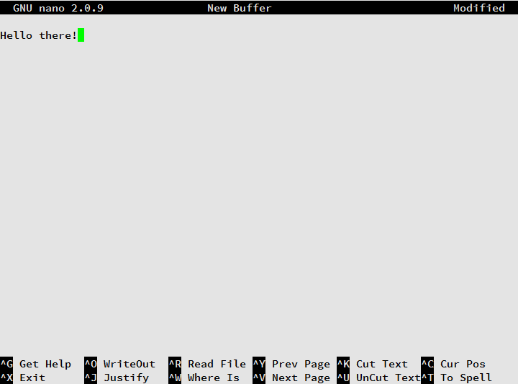
Simple & Easy!!
Notes:
Ctrl-g displays help

Slide 37
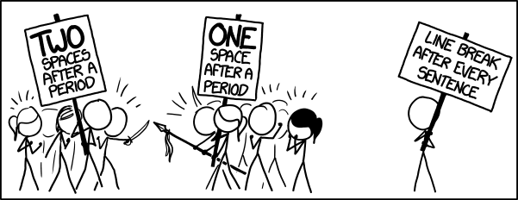
Aside: Line Endings
Different in *nux, older OSX and windows
Can break things in strange ways
$ dos2unix win_file.txt lin_file.txt

Slide 38
g/re/p
Where is the pattern?
Example
Where is the exact motif GGGGCAGG in a fastq
$ grep "GGGGCAGG" sample_2.fastq
$ grep --color "GGGGCAGG" sample_2.fastq
$ grep --color -nr "GGGGCAGG" sample_2.fastq
$ grep --color -m 2 -C 2 -nr "GGGGCAGG" sample_2.fastq
When would this not work how you’d expect?
Hint: line-wrapped sequence?
Notes:
(globally search a regular expression and print)
grep –v
grep -c

Slide 39
awk
Manipulating field-separated data
More advanced features superseded by modern languages like perl/python
Gives you symbols for each column
$number 0-> original line
$1 -> first column
#same as cat:
$ awk '{print}' Chip2comb_001b.sam

Slide 40
awk
Something more interesting
Where did things map?
Chromosome or contig stored in column 3 in sam files
$ awk '{print $3}' Chip2comb_001b.sam
#not quite what I wanted
$ awk '$1 !~ /^@/ {print $3}' Chip2comb_001b.sam
#there!

Slide 41
Redirection
I want to save this output!
Think of them as arrows
> #redirect thing left to file right
>> #append instead of overwriting
< #redirect file right to thing left
Concatenate files
$ cat *.fa > all.fa
Generate a smaller file to play with
$ shuf –n 100 big_file.txt > sample.txt
$ head –n 100 big_file.txt > sample.txt

Slide 42
Piping
Use the output of something as input for the next!
Recall our awk getting contigs mapped
Try this:
$ awk '$1 !~ /^@/ {print $3}' Chip2comb_001b.sam | sort
$ awk '$1 !~ /^@/ {print $3}' Chip2comb_001b.sam | sort | uniq
$ awk '$1 !~ /^@/ {print $3}' Chip2comb_001b.sam | sort | uniq –c
What’s going on here?

Slide 43
Convert a sam back into fastq?
$ awk '!/^@/ {print "@"$1"\n"$10"\n+\n"$11}' sample.sam > sample.fastq
#for bam files
$ samtools view sample.bam | \
awk '!/^@/ {print "@"$1"\n"$10"\n+\n"$11}' > sample.fastq
#for all of them:
for s in *.bam
do
samtools view $s | awk '!/^@/ {print "@"$1"\n"$10"\n+\n"$11}' > ${s/%bam/fastq}
done

Slide 44
Questions? Brainstorms?

Slide 45
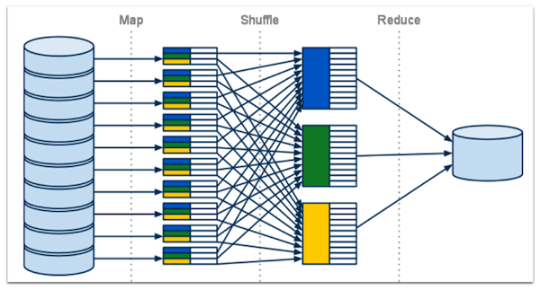
Saving time
Many operations are parallelizeable
Break into chunks then collate back together
Called MapReduce

Slide 46

Do all of the things!
Pleasure ∝ # of CPUs
Give it a list of commands
Give it one command to break into pieces
$ parallel < joblist.txt
#just 2 CPUs at a time
$ parallel –j 2 < joblist.txt
#add column 1 in big_file.txt
$ cat big_file.txt | parallel --pipe awk \'{x+=\$1} END {print x}\' | awk '{y+=$1} END {print y}'

